Slide 1
Wikipedia Search Engine
Team : Data Knights, A.K.G.E.C. Ghaziabad
(Madhav Agarwal)
(Raj Kumar Maurya)
(KUNWAR ASHUTOSH SINGH)

Slide 2
What We Have Developed
A search engine dedicated to Wikipedia

Slide 3
Project Architecture
Hadoop 2.7.3 Cluster of 3 EC2 Instances on AWS Cloud (Self Configured)
Spark 2.1 Cluster on top of YARN
Wikipedia Data Dump
Web UI using Django (hosted on AWS)

Slide 4
Language & Platform Used
Technologies Used
Apache Hadoop 2.x
Apache Spark 2.x
Django
AWS
Python
Linux (Ubuntu)

Slide 5
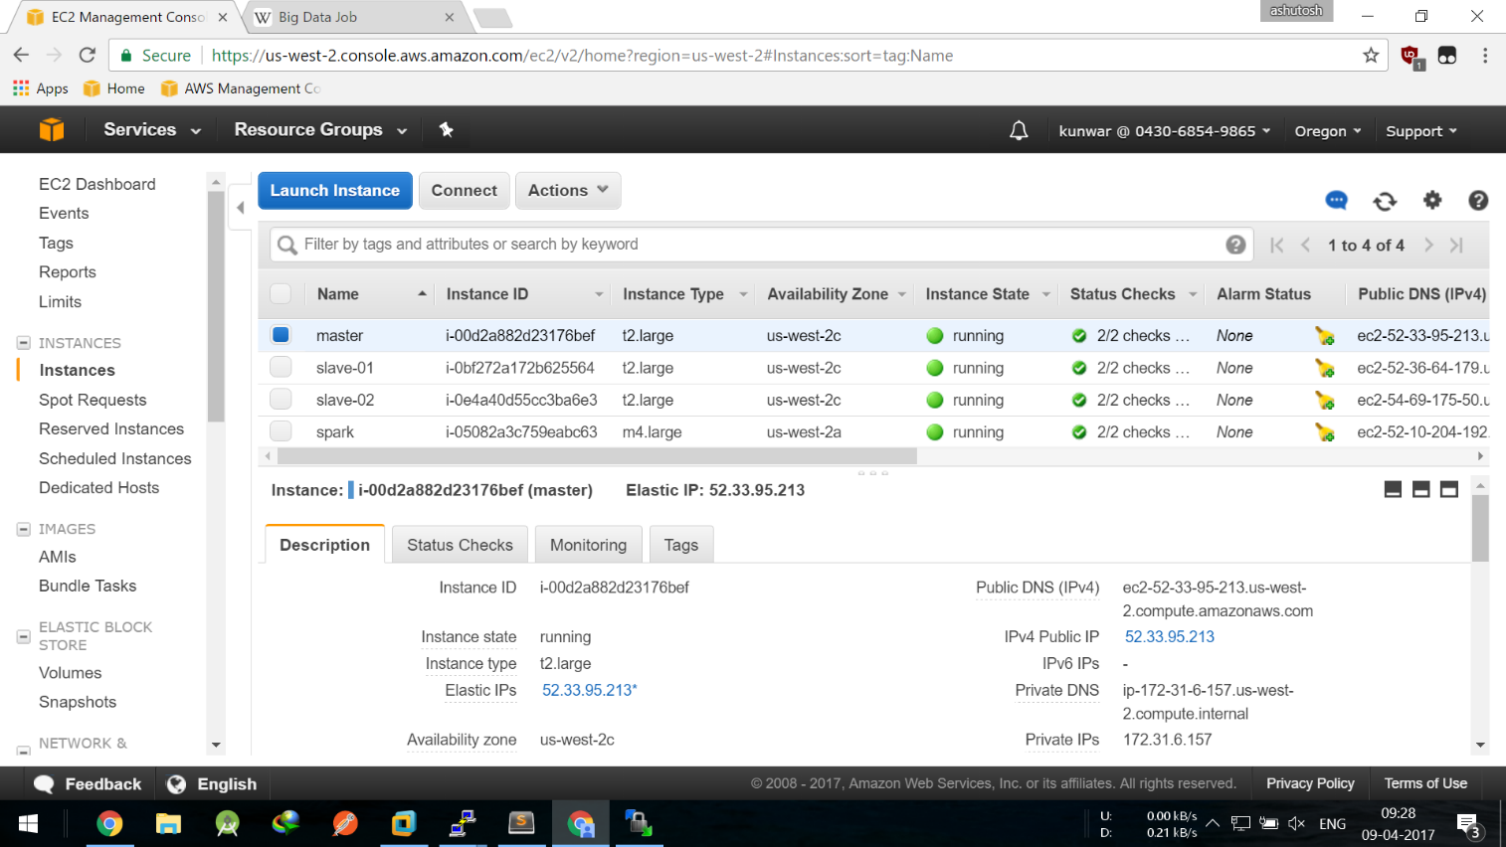
Hadoop 2.7.2 Cluster on AWS

Slide 6
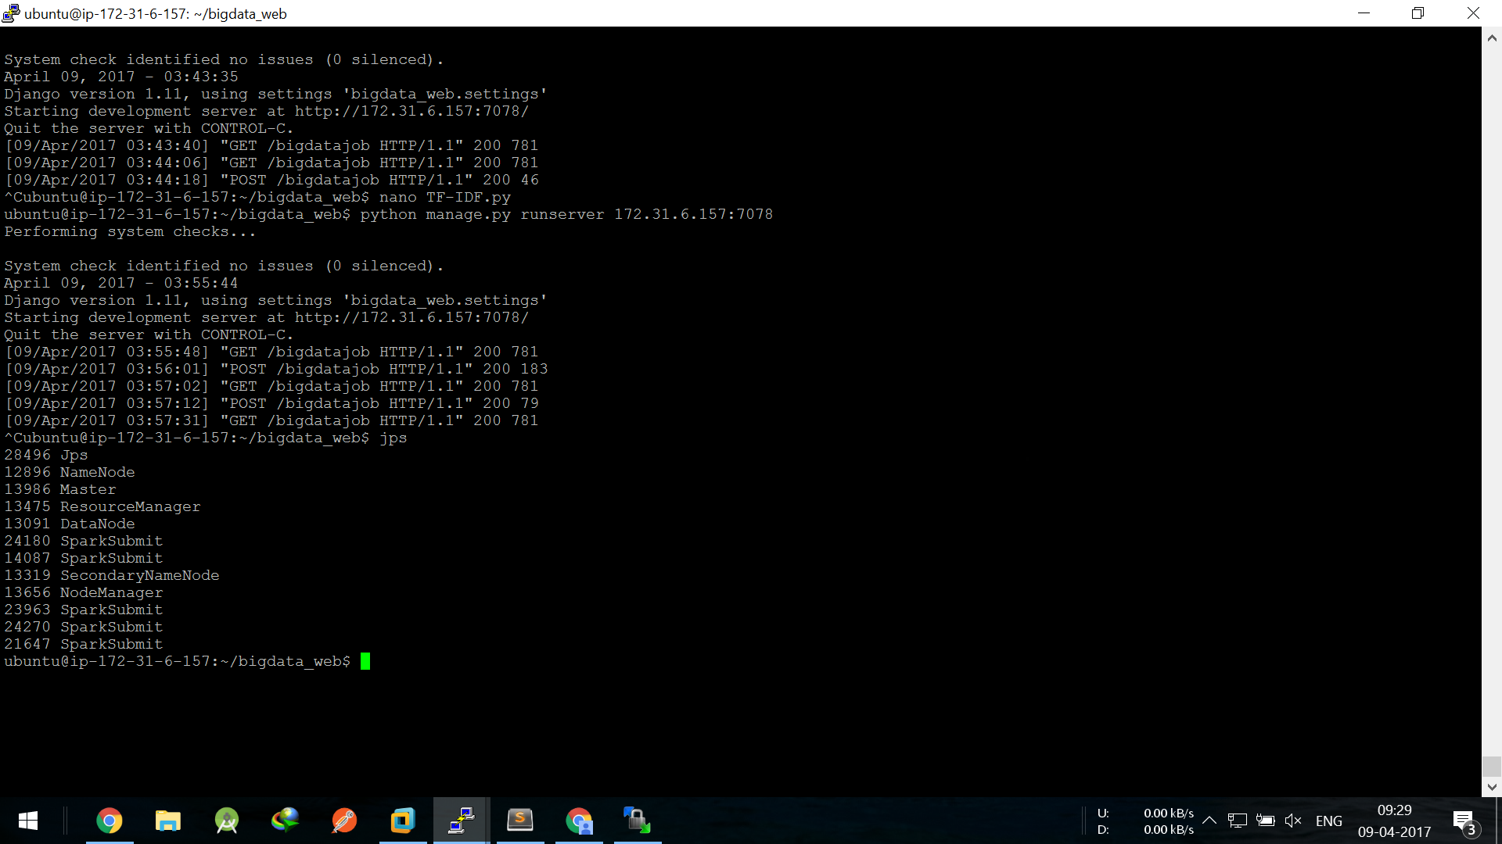

Slide 7
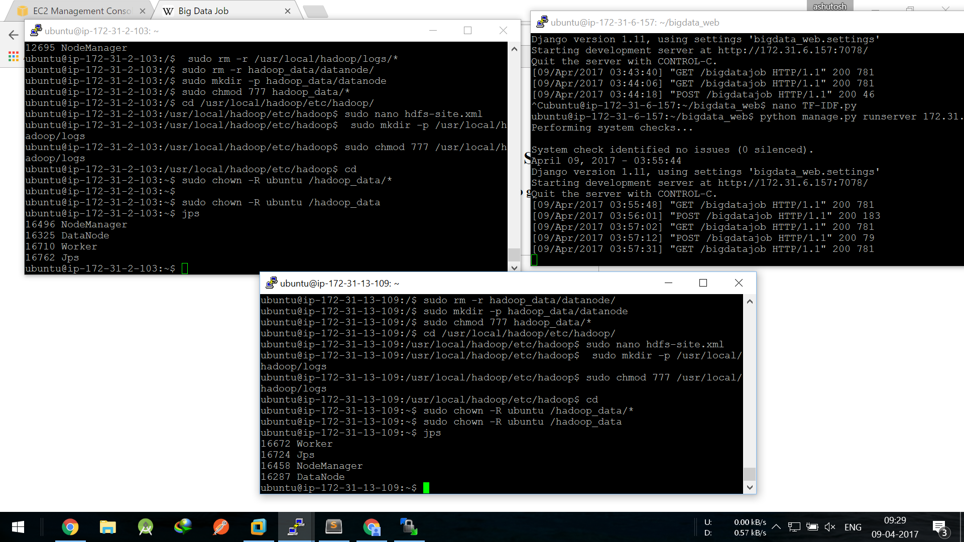
SPARK CLUSTER on YARN

Slide 8
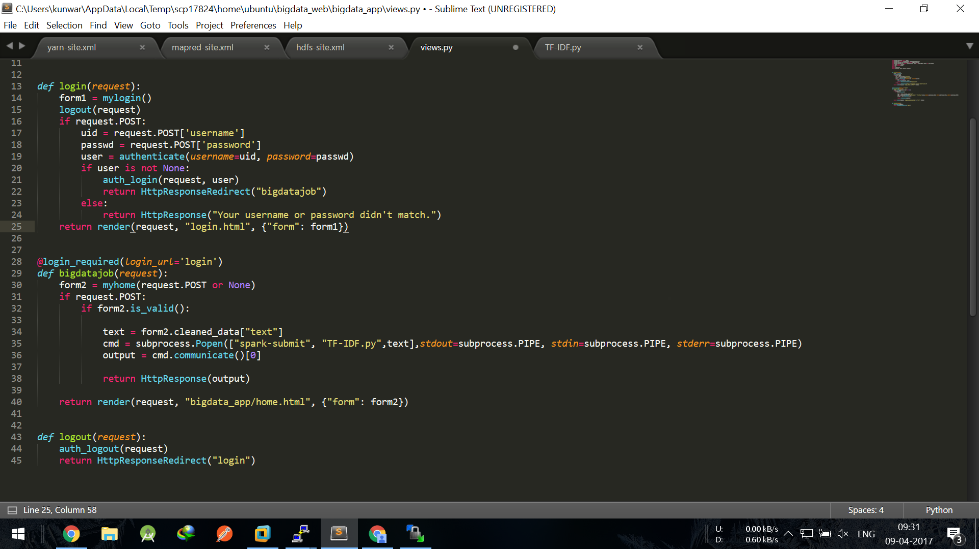
Web UI using Django

Slide 9

Why Spark!!
Efficient to handle & process Big Data
Provides efficient and scalable Machine Learning Library
Widely used by Data Scientists to process Big Dataz

Slide 10
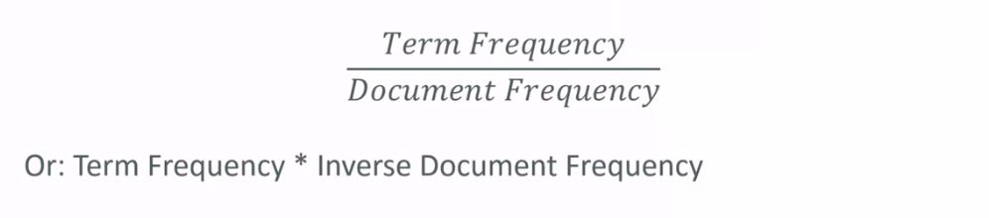
A step towards Search Engine!
Building block of our search algorithm: TF-IDF
TF: Term Frequency
IDF: Inverse Document Frequency
TF-IDF figures out what terms are most relevant for a document

Slide 11
TF-DF
Term Frequency is just measures how often a word occurs in a document
“A word that occurs frequently is probably important to that document’s meaning”
Document frequency is how often a word occurs in an entire set of documents i.e. all of wikipedia pages
This tell us about common words that just appear everywhere no matter what the topic is, like ‘is’, ‘the’, ‘and’ etc.

Slide 12
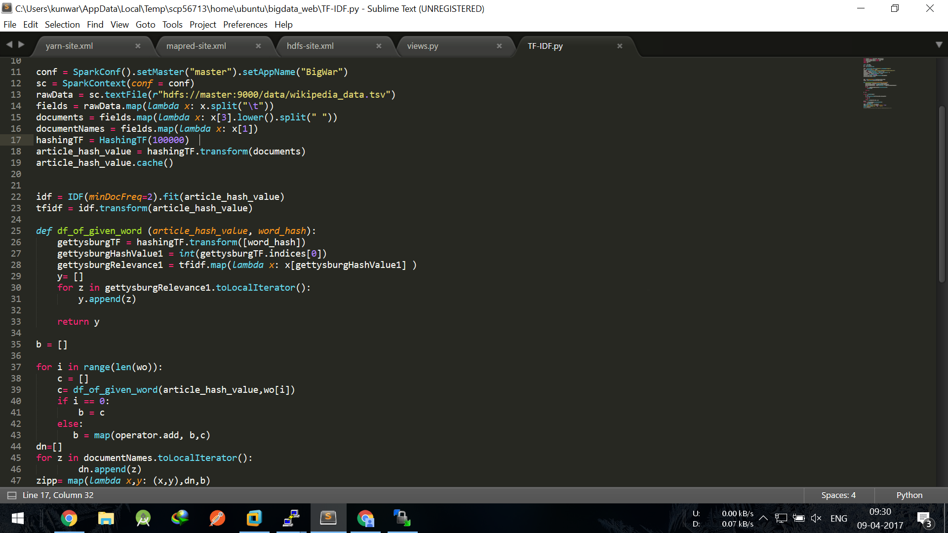
TF-IDF Code

Slide 13
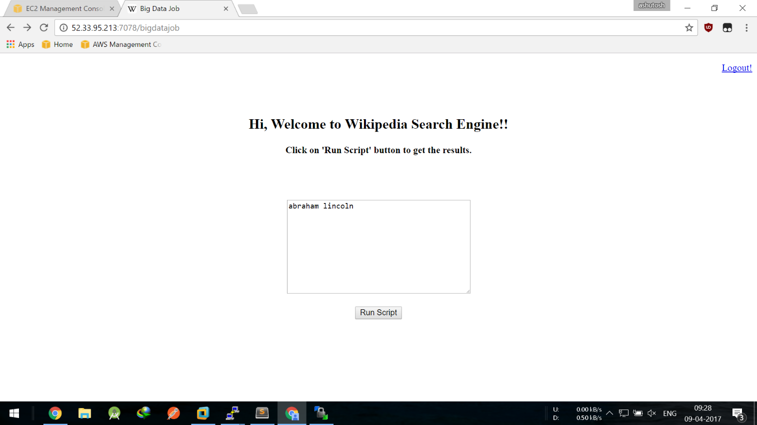

Slide 14
THANK YOU

